Slide 3
Kako razvijati kvalitetne mobilne aplikacje s alatima Xamarin: UITest, Test.Cloud i Insights
Miljenko Cvjetko
Developer
Software Engineer on Xamarin Components Team
mcvjetko@holisticware.net
miljenko.cvjetko@xamarin.com
https://holisticware.net
https://xamarin.com

Slide 4


Xamarin.Process Quality
QUALITY HIGH IMPORTANCE mobile not only mobile

Slide 5
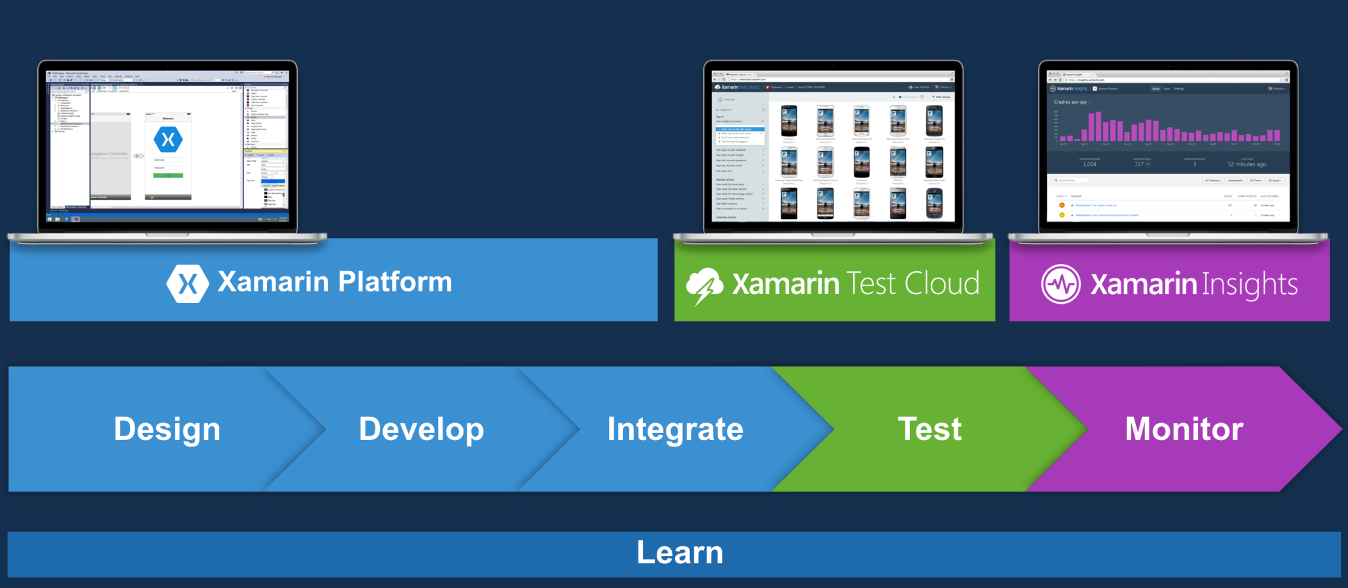
Xamarin.Process
Xamarin.Process
2014.Q3
Full / Complete App Development Process
Xamarin.Process
Features stable phase for: Design and Development Tools
Features – extensions: Testing

Slide 6
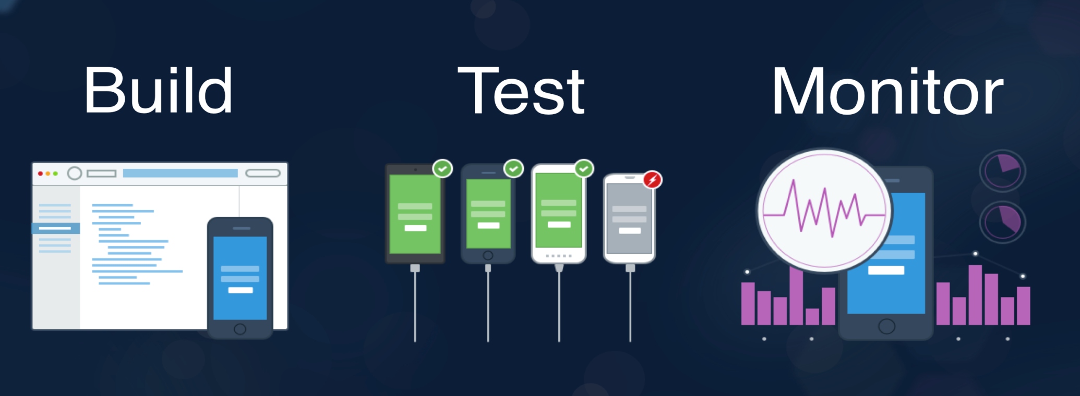
Xamarin.Process.Test
Testing part of the process
Design
Build
Integrate
Deploy
Test
Monitor
Test Tools and Services
Xamarin.UITest
Xamarin.Test.Cloud
Xamarin.Insights

Slide 7
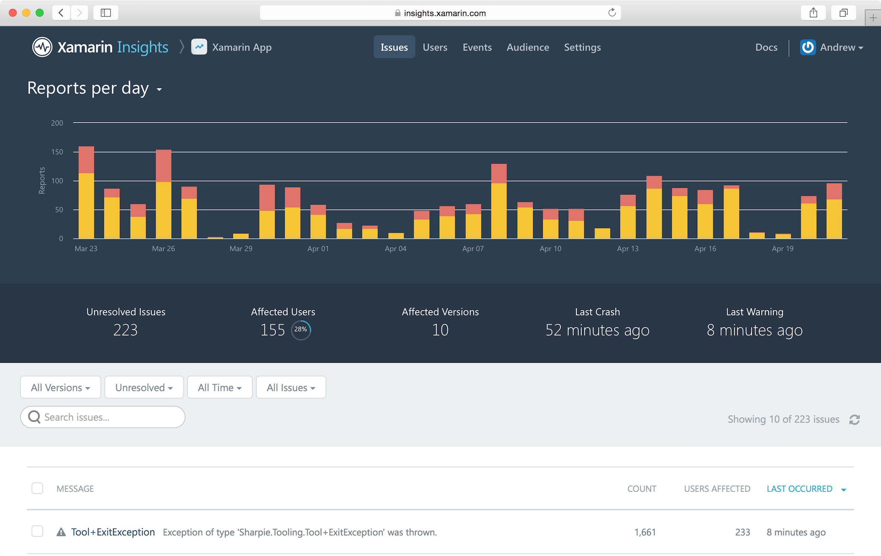
Xamarin.Process.Monitoring – Insights 01
Monitoring
Production apps (not only)
Xamarin.Insights https://xamarin.com/insights https://insights.xamarin.com
Purpose
Crash and issue reporting
Session and user monitoring
Secure/private
.net PCL

Slide 8
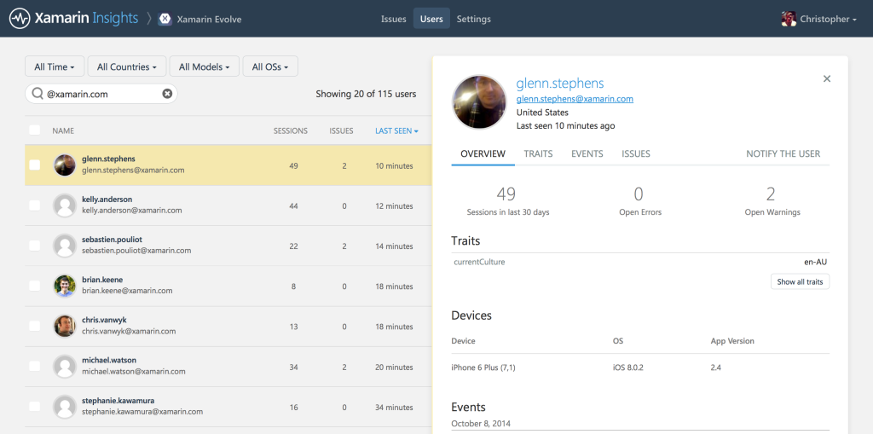
Xamarin.Process.Monitoring – Insights 02
Platforms
Mobile Xamarin.Android Xamarin.iOS Windows Phone (8, 8.1WinRT, 8.1SL?)
Desktop Windows MacOSX
ASP.net ??
Architecture
client/server
Client Xamarin.Insights – PCL
Server – Insights portal https://insights.xamarin.com/app/

Slide 9
Xamarin.Process.Monitoring – Insights 03
Process
Setup Application on the server/portal https://insights.xamarin.com/app/
Prepare apps for monitoring add nuget packages
Initialize application
Monitor

Slide 10
Xamarin.Insights Monitoring

Slide 11
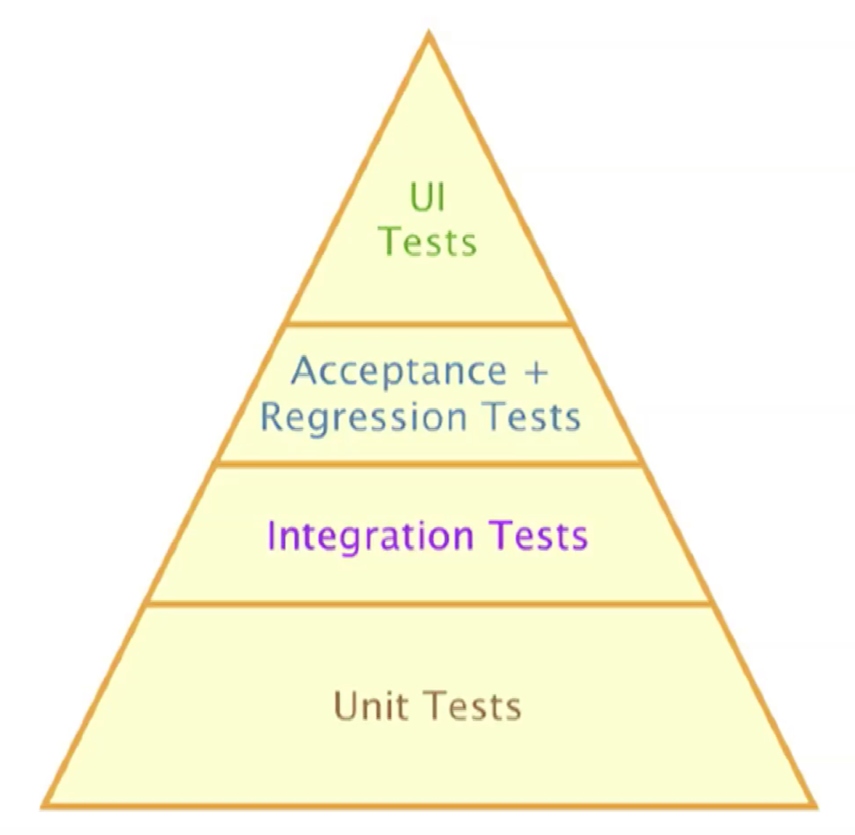
Xamarin.Process.Test – Testing 01
Test types
Unit Testing API testing (libraries) – internals .net: nunit, MSTest, xUnit
Integration Testing
Regression Testing
UI/Acceptance/Functional Testing end to end user interaction simulation
Test process
Arrange prepare test (data, envirnonment)
Act do something perform actions
Assert Validate/Verify results

Slide 12
Xamarin.Process.Test – UITest 01
Xamarin.UI test
automating testing library
enables
querying UI to find out information about controls/views/widgets
simulation of user interactions
based on
Calabash popular device UI testing framework
Nunit enables creating readable c# UI Tests for
iOS (+Xamarin.iOS)
Android (+ Xamarin.Android)
hybrid apps
tests run
locally on
emulator/simulator
device

Slide 13
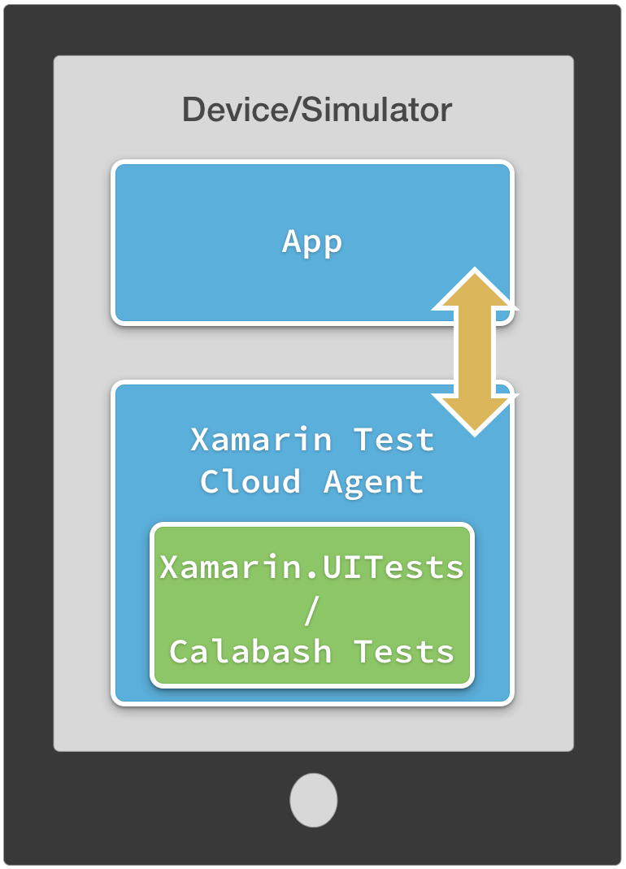
Xamarin.Process.Test – UITest 02
Architecture & Project Types
Client / server
Client - NUnit library
Server – embedded in the App HTTP + JSON protocol
Client - Nunit library
unit testing
Arrange
Act
Assert
Communicates with server
Server
Calabash
iOS embedded in the app must be explicitly started in FinishedLaunching
Android service signed with the same key (the same app)

Slide 14
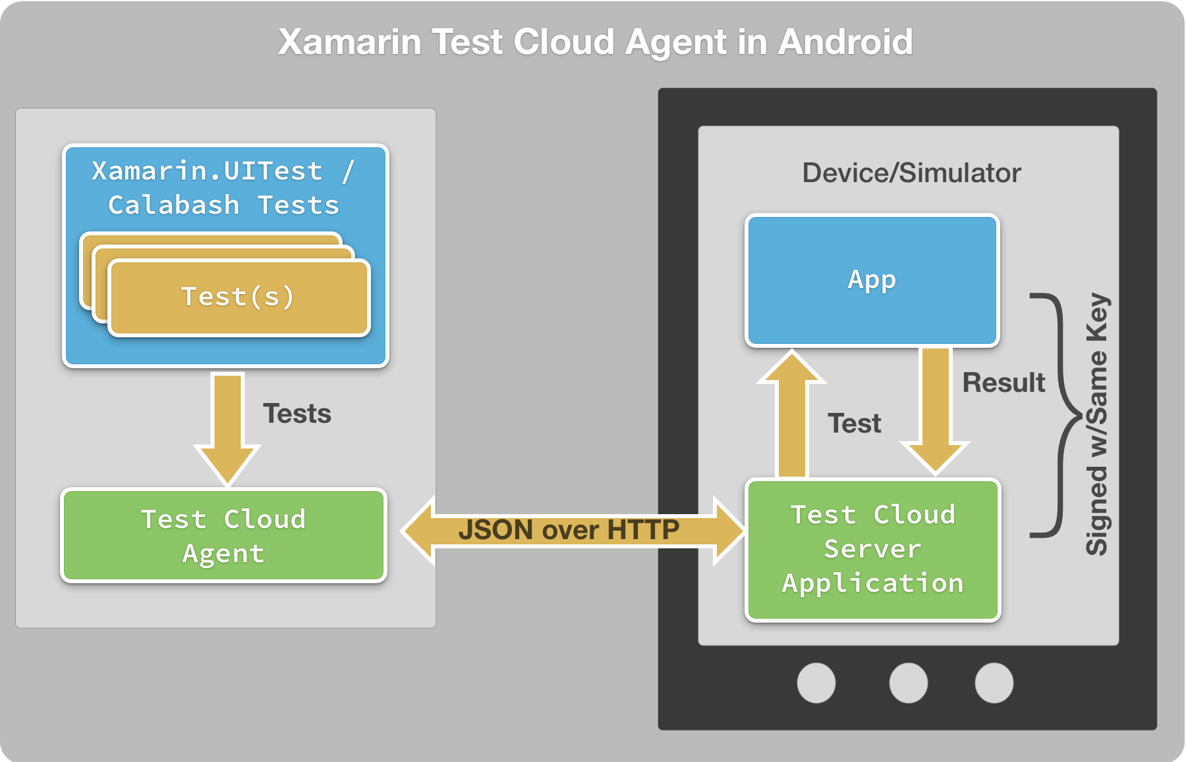
Xamarin.Process.Test – UITest 03
Architecture.Android

Slide 15
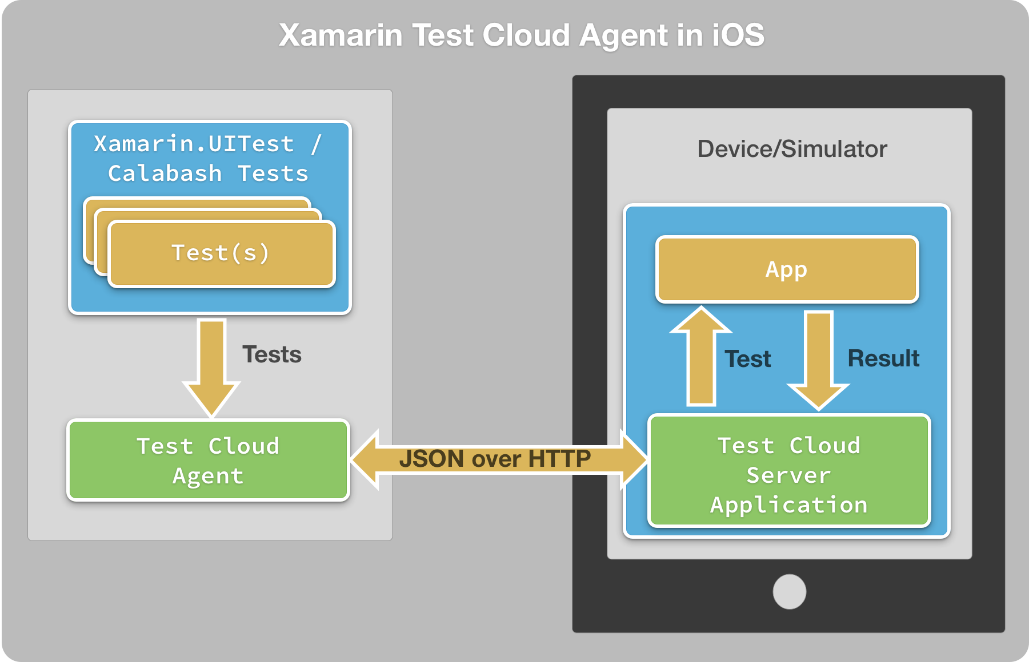
Xamarin.Process.Test – UITest 04
Architecture.iOS

Slide 16
Xamarin.Process.Test – UITest 05
Arrange
Iapp interface
Factory builder ConfigureApp
AndroidApp
iOSApp
Fluent Interface (extension methods)
Loading
ApkFile(“path”)
AppBundle(“path”)
InstalledApp(“identifier”)
StartApp()
app = ConfigureApp.iOS .InstalledApp("com.company.app") .StartApp(); app = ConfigureApp.Android .ApkFile(“../../../blah/blah.apk") .StartApp();

Slide 17
Xamarin.Process.Test – UITest 05
Act
Iapp interface
Acting on UI elements (controls/views/widgets)
app.Query(); // DOM object graph/trees - detailedAppResult[] ar = app.Query(); // save the results
app.Flash(<SELECTOR>); // flash object/control/view
App.Repl(); // Read Eval Print Loop - interpreter
tree // ui tree DOM
copy // copy history to clipboard app.Tap(c => c.Marked(“button“)); app.EnterText(c => c.Id("txtName", "text"));
app.WaitFor();
app.WaitForElement(); app.Tap();
app.SwipeLeft();
app.ScrollDown();

Slide 18
Xamarin.UITest

Slide 19
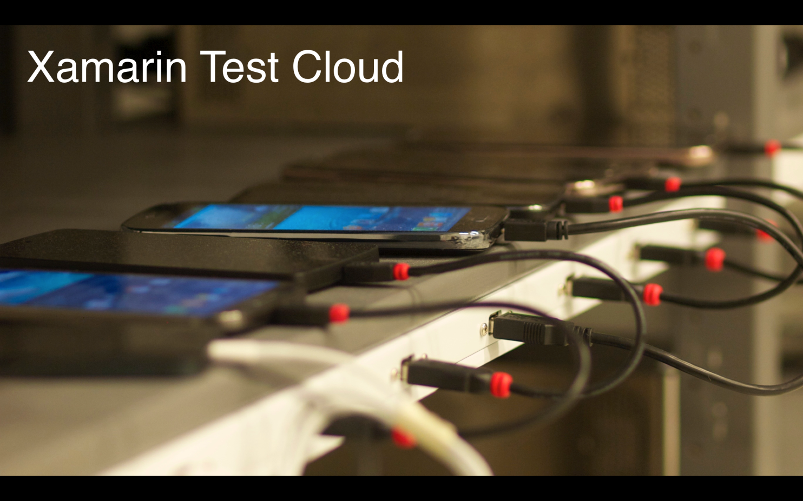
Xamarin.Process.Test – Test.Cloud 01
Xamarin.Test.Cloud
Cloud Service for UI Testing
Runs
Xamarin.UITests and
Calabash Tests
UITests
Upload
Run
https://xamarin.com/test-cloud
https://testcloud.xamarin.com/

Slide 20
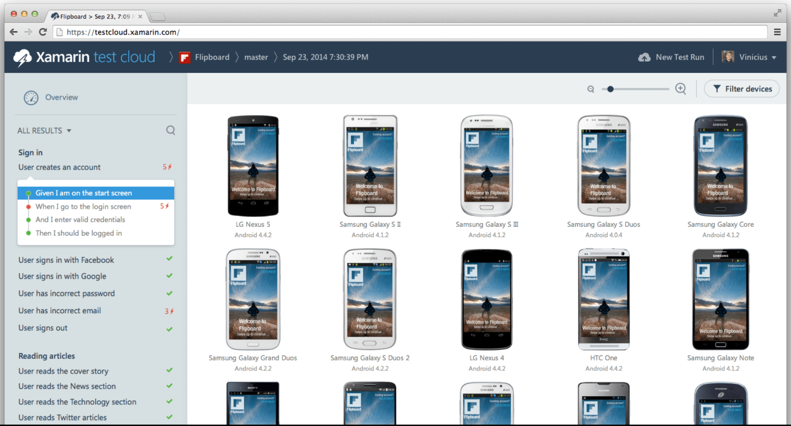
Xamarin.Process.Test – Test.Cloud 02
1800+ Devices (real devices) 2015-09-01 https://testcloud.xamarin.com/devices
Android
iOS

Slide 22
Popunite ankete i osvojite vrijedne nagrade!
Ankete su dostupne na:
Mobilnim uređajima (Android, Apple, Windows)
Web-u http://www.mobilityday.com
PIN za pristup se nalazi na poleđini akreditacije i u vašem on-line profilu.

Slide 23
Xamarin.Process.Test – Test.Cloud 03
Fun Facts
https://www.youtube.com/watch?v=PQMBCoVIABI&feature=youtu.be&t=3431
Links
https://github.com/moljac/HolisticWare.Talks.MobilityDay.2015

